Slide 1
Customer Discovery Report
Week 2

Slide 2
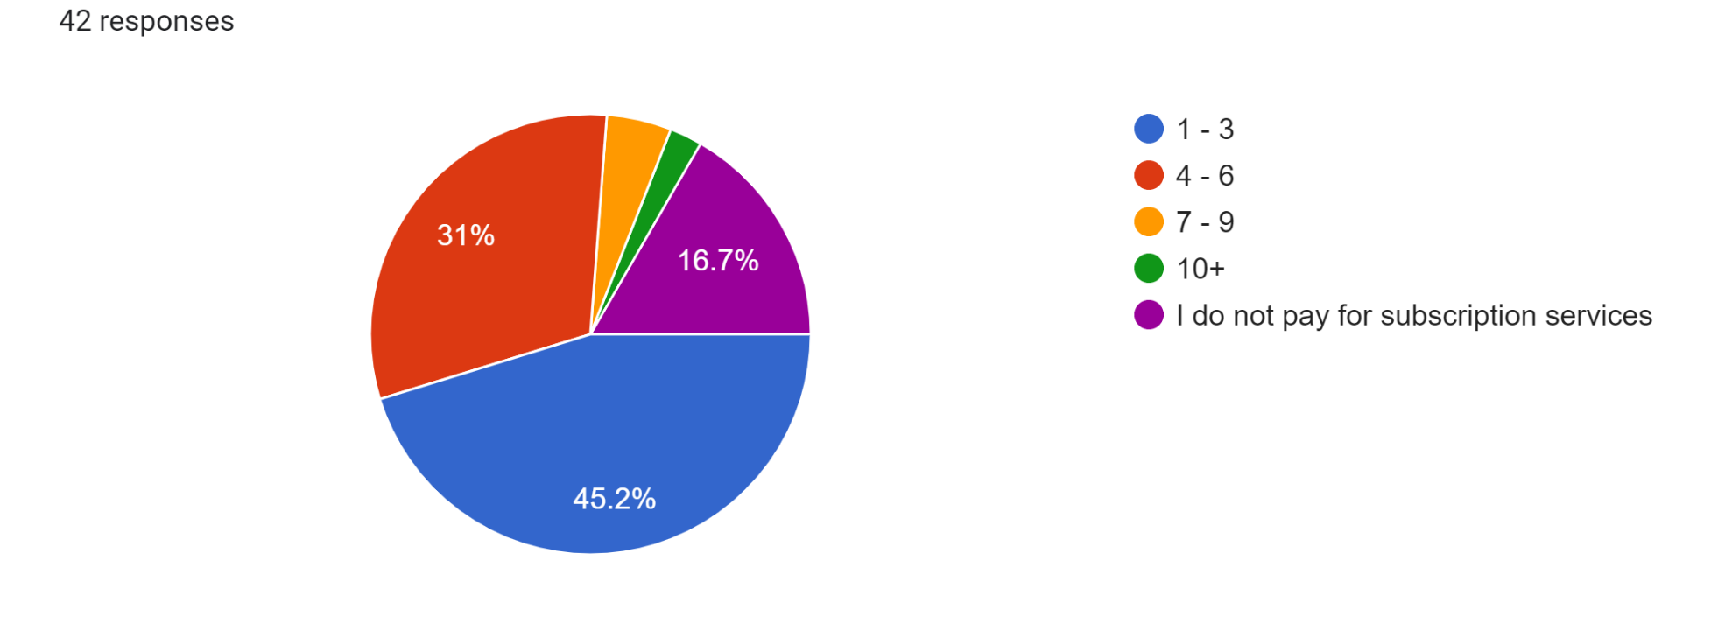
How many subscription services do you pay for each month?

Slide 3
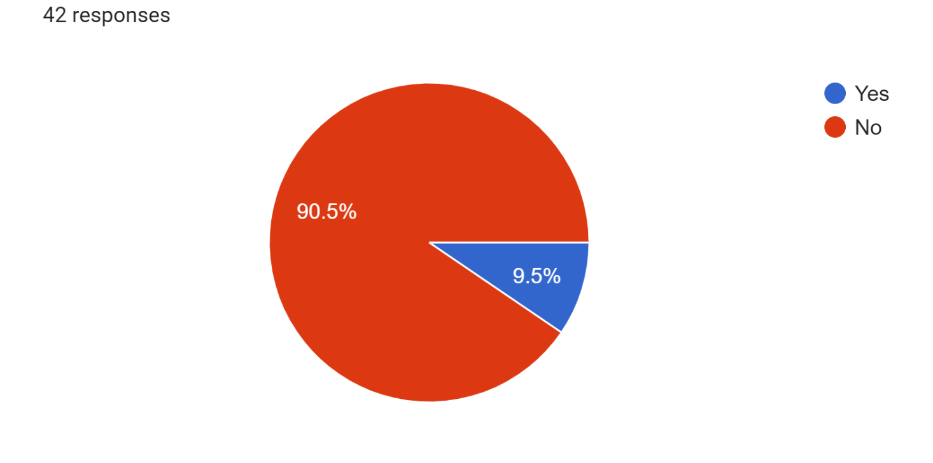
Have you ever used a supplement subscription service?

Slide 4
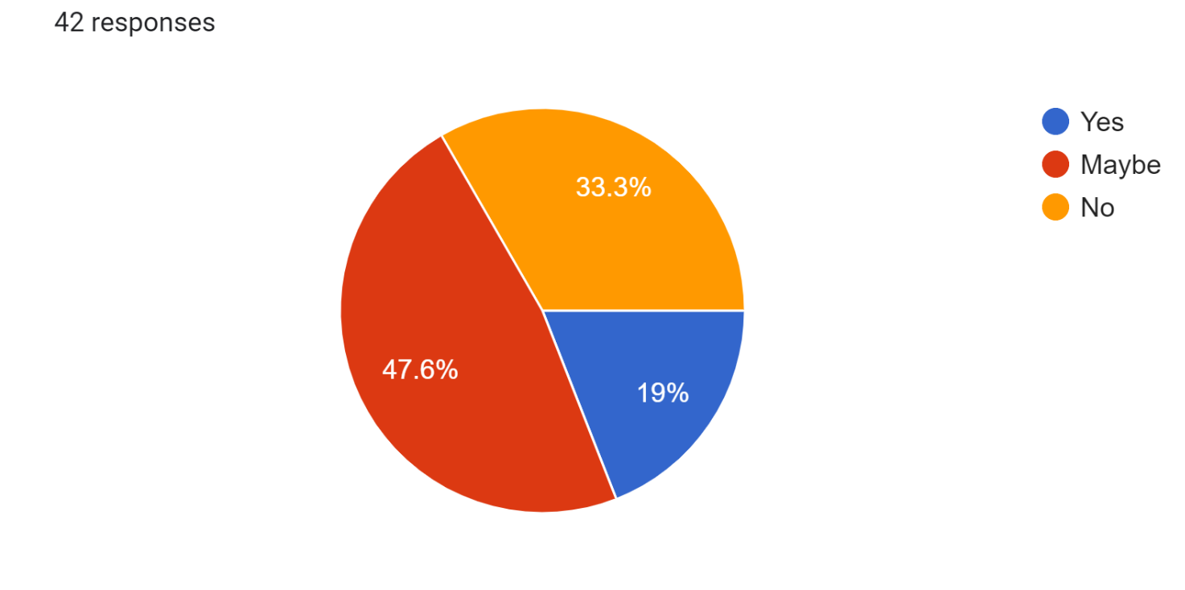
Would you consider using this supplement subscription?

Slide 5
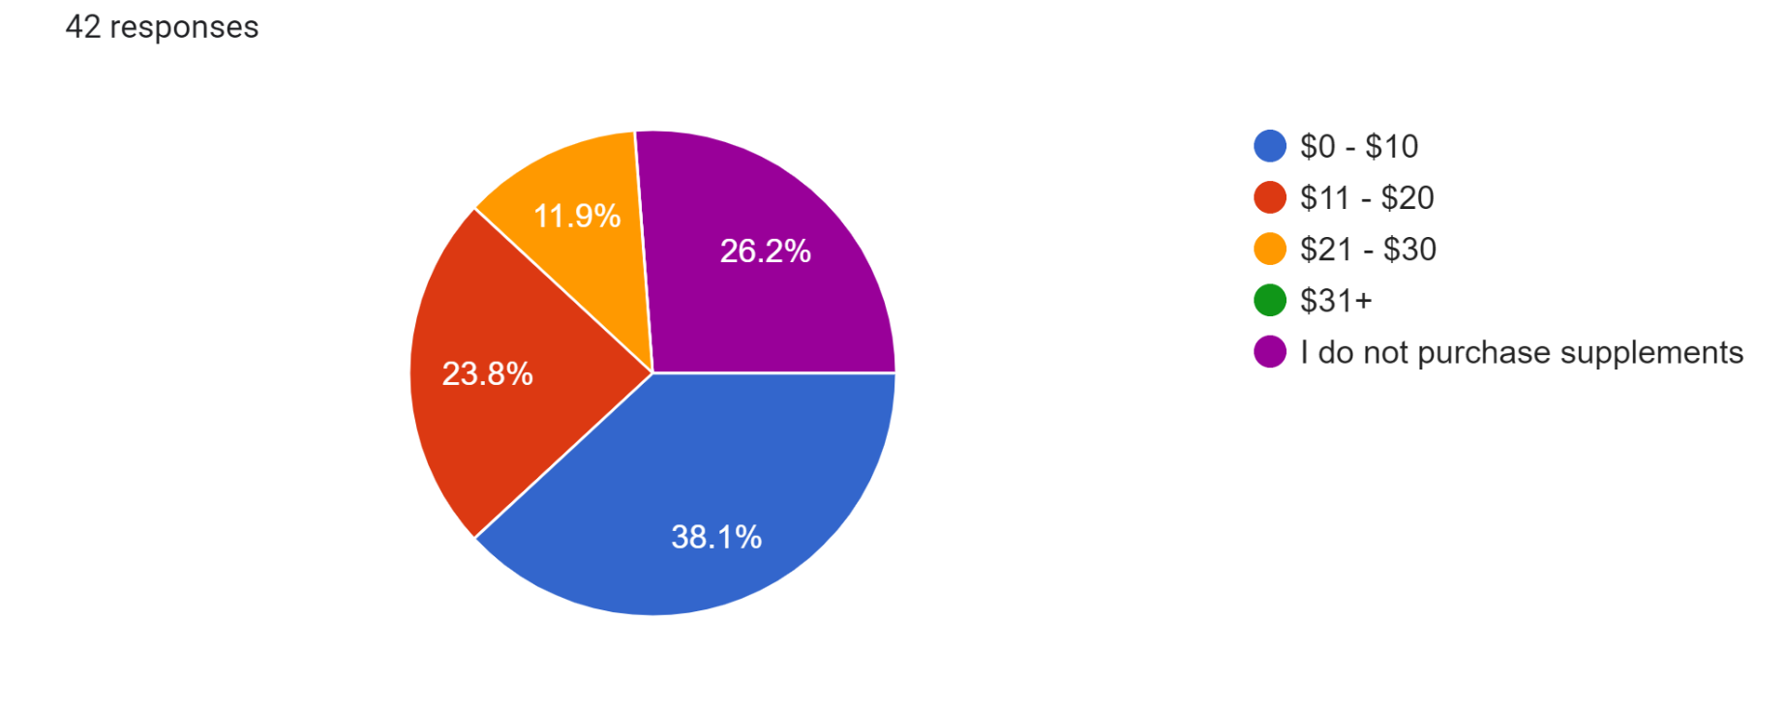
“What price would you expect to pay for monthly, personalized supplements?”

Slide 6
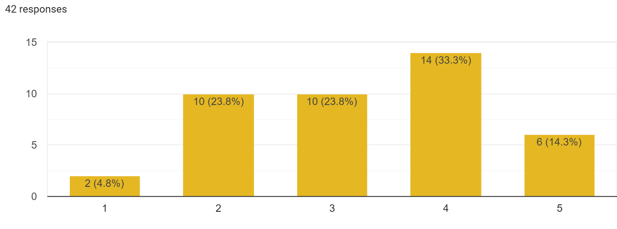
What do you think about our company’s business model?
ansora uses genetic data to personalize nutrition. We collect DNA samples and use microarray data to quantify what nutrients each individual needs for optimal focus, energy, and health. Using this information, personalized vitamin supplements are sent out monthly via a subscription. We also offer pre-mixed supplement blends for purchase.

Slide 7

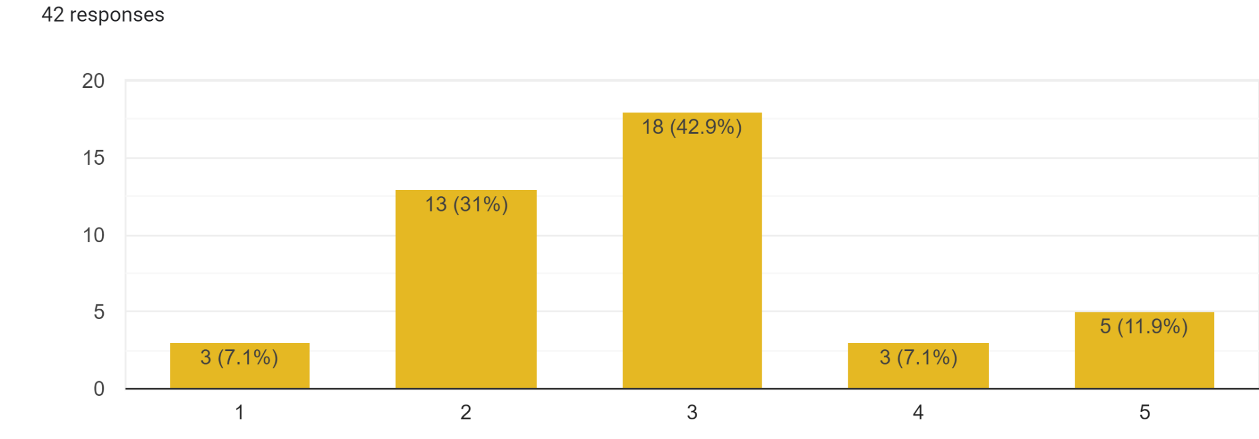
What do you think of our company’s name?

Slide 8
What would be the most influential in your decision to use this service?
Affordability
Quality
Data to back up results
Convenience

Slide 9
Ideal price ranges - according to responders
10-15$
15-20$
20$
50$
40$
25-50$

Slide 10
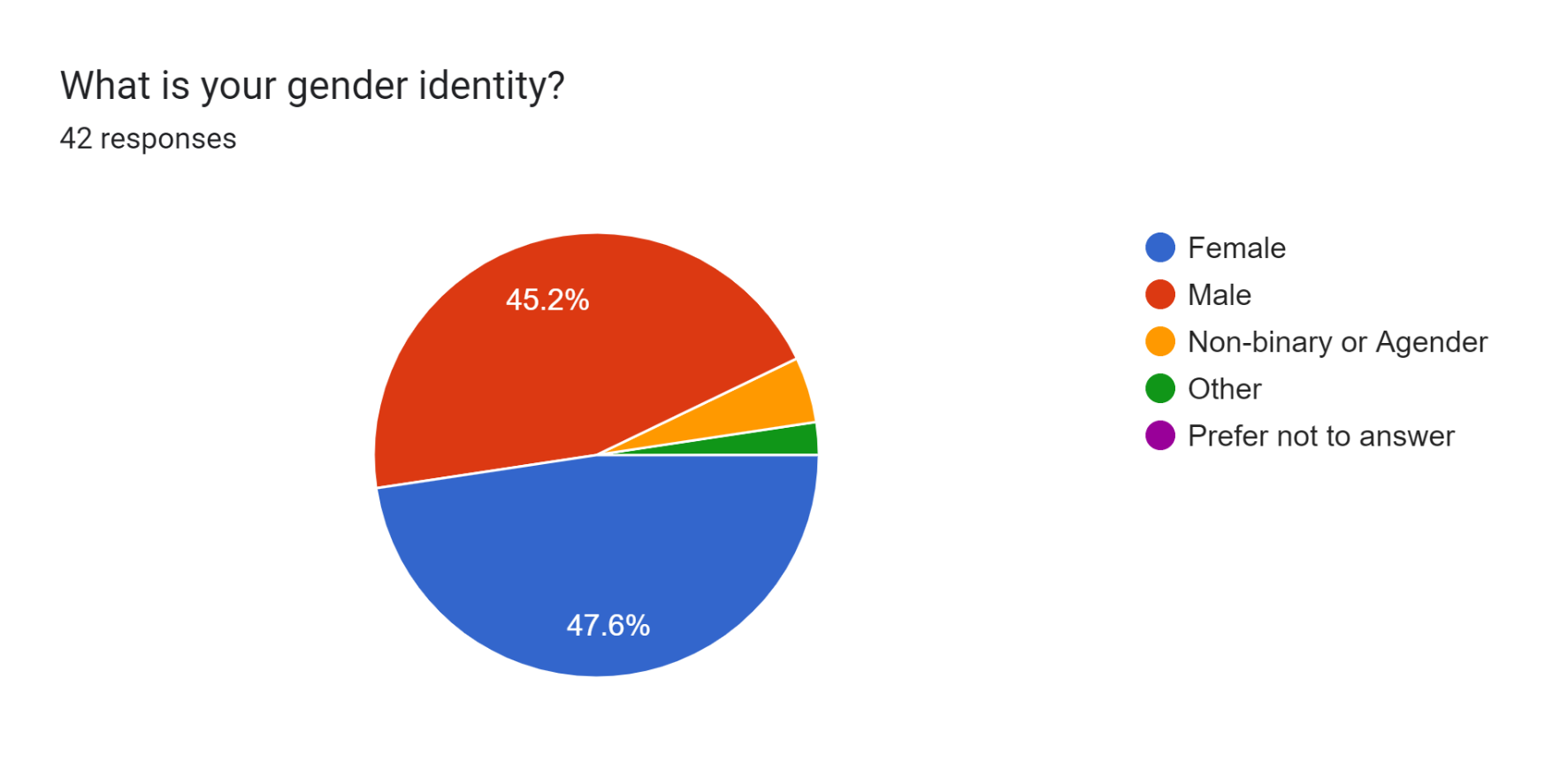
Demographic Analysis - Gender

Slide 11
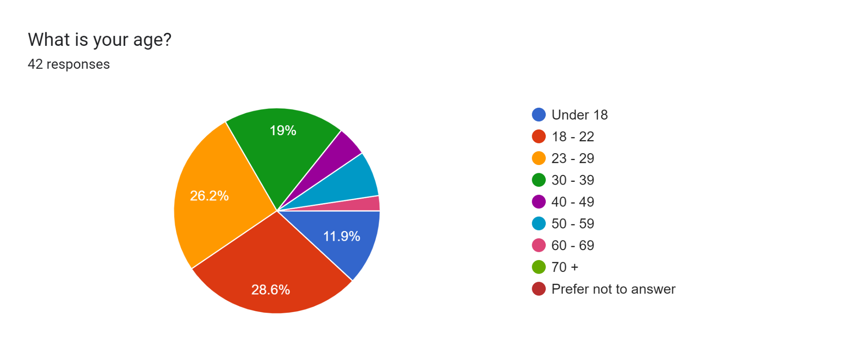
Demographic Analysis - Age

Slide 12
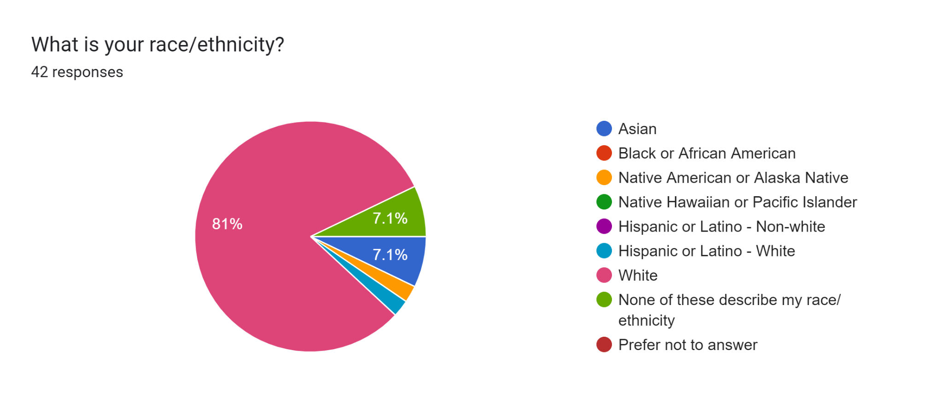
Demographic Analysis - Race

Slide 13
Helpful comments
“I know there are companies with similar business models, not sure if anyone’s using DNA to augment supplement recommendations. Name is perfect. Starts with an “a”, doesn’t mean anything, 6 letters, beautiful. If suppies (fun little name for free) are prepackaged per day, use biodegradable materials to best the competition from an environmental standpoint. Forbid anyone working on this project from wearing a black turtleneck. Shit’s a bad omen, ya know?”
“Some people may buy this, but I would be very wary of protecting data about myself. Collecting DNA samples is a big ask in order to sell supplements, especially when I personally regard the sale of supplements to be a bit of a shady business to begin with. At least in the United States, no regulatory body exists which tests and verifies the efficacy or safety of dietary supplements.”
“I would want assurance of my information to be private”

Slide 14
Honorable mentions
“The current science does not support your business model.”
“Your idea sounds like pseudoscientific bullshit, but there are probably enough people who would believe that kind of nonsense to make this a viable business idea.”

